Slide 1

Smart FOTA System
Shoubra Faculty of Engineering

Slide 2






Team Members
Problem Definition
01
04
V2V Flashing
Why cars need FOTA?
Working Flow
How flashing V2V Works.
Introduction to FOTA
02
05
Security
What is FOTA?
How we secure the over all system
Bootloader
03
Mazen Khaled
Abdelrahman
Ahmed Khaled
Yousif Anwar
Sayed Reda
06
PCB Design
How flashing technique happens.
FOTA Developer
V2V Developer
Security Developer
07
Future Work

Slide 3

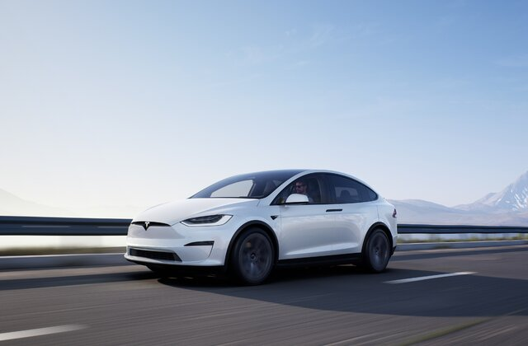


Table of Contents
Problem Definition
01
Why cars need FOTA?
Working Flow
Introduction to FOTA
02
What is FOTA?
Bootloader
03
How flashing technique happens.
04
V2V Flashing
How flashing V2V Works.
05
Security
How we secure the over all system
06
PCB Design
07
Future Work

Slide 4
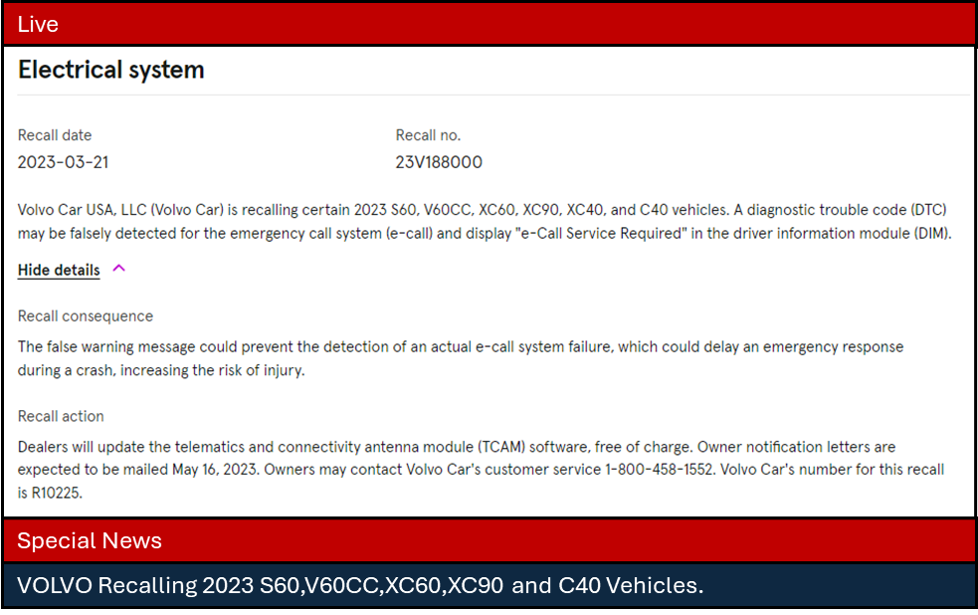
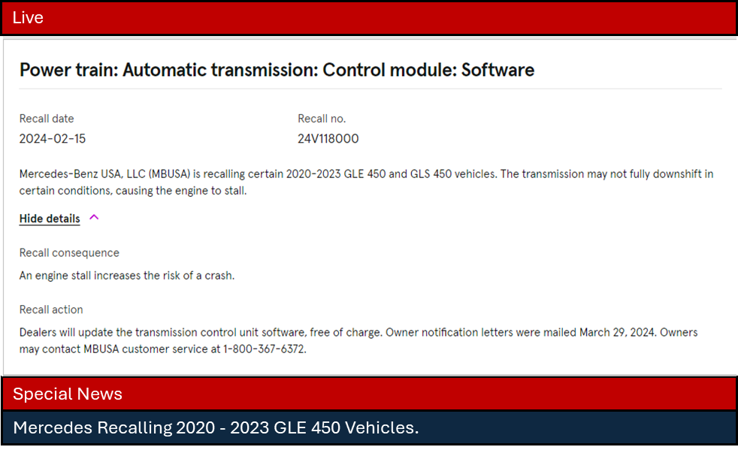
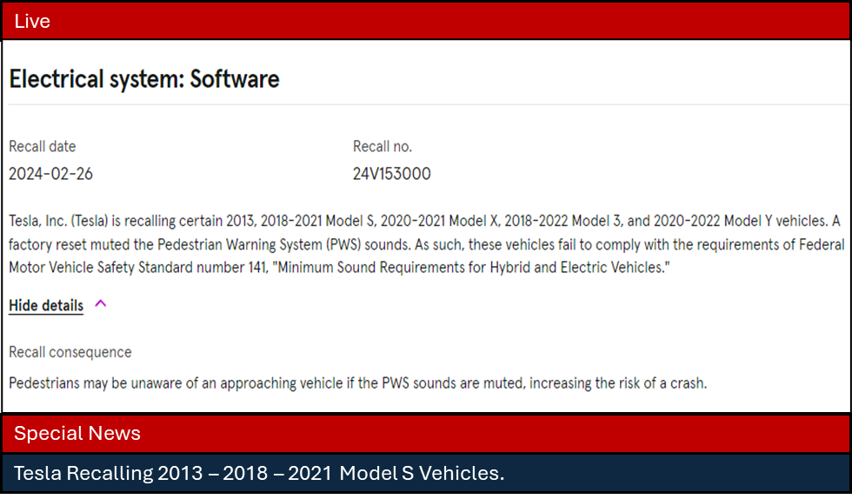
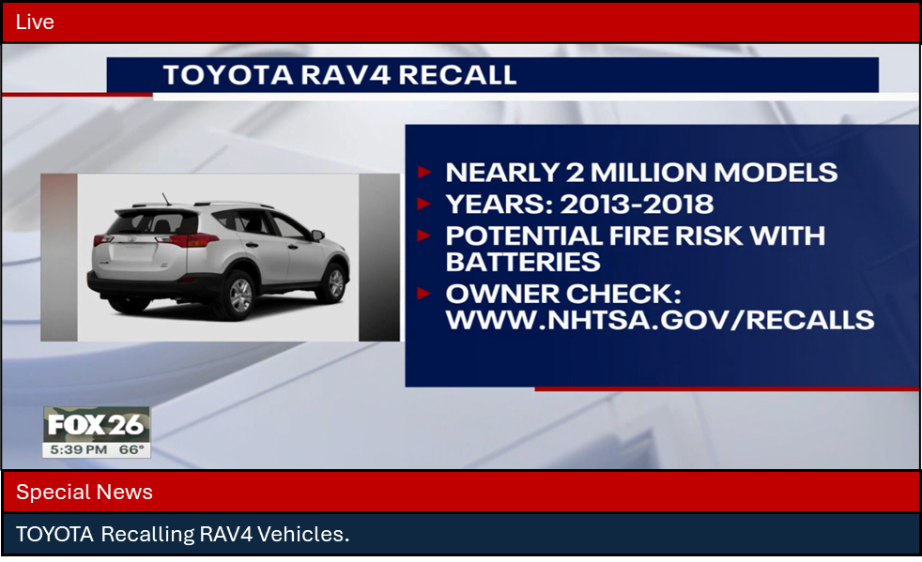
01

Slide 5
Working Flow

Slide 6
Start
Brainstorming To Solve the problems
Problem solved?
No
Working Flow
Check with GP Mentor
Introduction
to FOTA
02
Gathering the Problems and ideas
Divided To Groups
FOTA
V2V
Security
Error Happened?
Error Happened?
Error Happened?
No
No
No
Project Integration
End

Slide 7
What is FOTA?
Introduction
to FOTA
02
Integration of a reliable bootloader and a secure FOTA update mechanism ensures that devices can be updated remotely, enhancing their functionality, security, and reliability over time.

Slide 8
Check for Update:
Determine the availability of newer firmware versions from the server (Firebase).
Get the Update from the Server:
This process encompasses establishing a secure connection, downloading the firmware update package, and validating the version of the downloaded update.
Encryption:
Implemented AES encryption as an advanced security measure, creating a unique code accessible only to your device and the server.
V2V:
Used to update the car via secure authenticated vehicles.
OTP For Authentication:
Used for verify the update to the user.
What is FOTA?
FOTA Features
Integration of a reliable bootloader and a secure FOTA update mechanism ensures that devices can be updated remotely, enhancing their functionality, security, and reliability over time.

Slide 9





Processes Overview
OTP Key
Developer
AES
Encryption
AES
Decryption
Vehicle 1
Firebase through https server
Car 1
Vehicle 2
Car 2
OTP Key

Slide 10
FOTA Features
Check for Update:
Determine the availability of newer firmware versions from the server (Firebase).
Get the Update from the Server:
This process encompasses establishing a secure connection, downloading the firmware update package, and validating the version of the downloaded update.
Encryption:
Implemented AES encryption as an advanced security measure, creating a unique code accessible only to your device and the server.
V2V:
Used to update the car via secure authenticated vehicles.
OTP For Authentication:
Used for verify the update to the user.

Slide 11
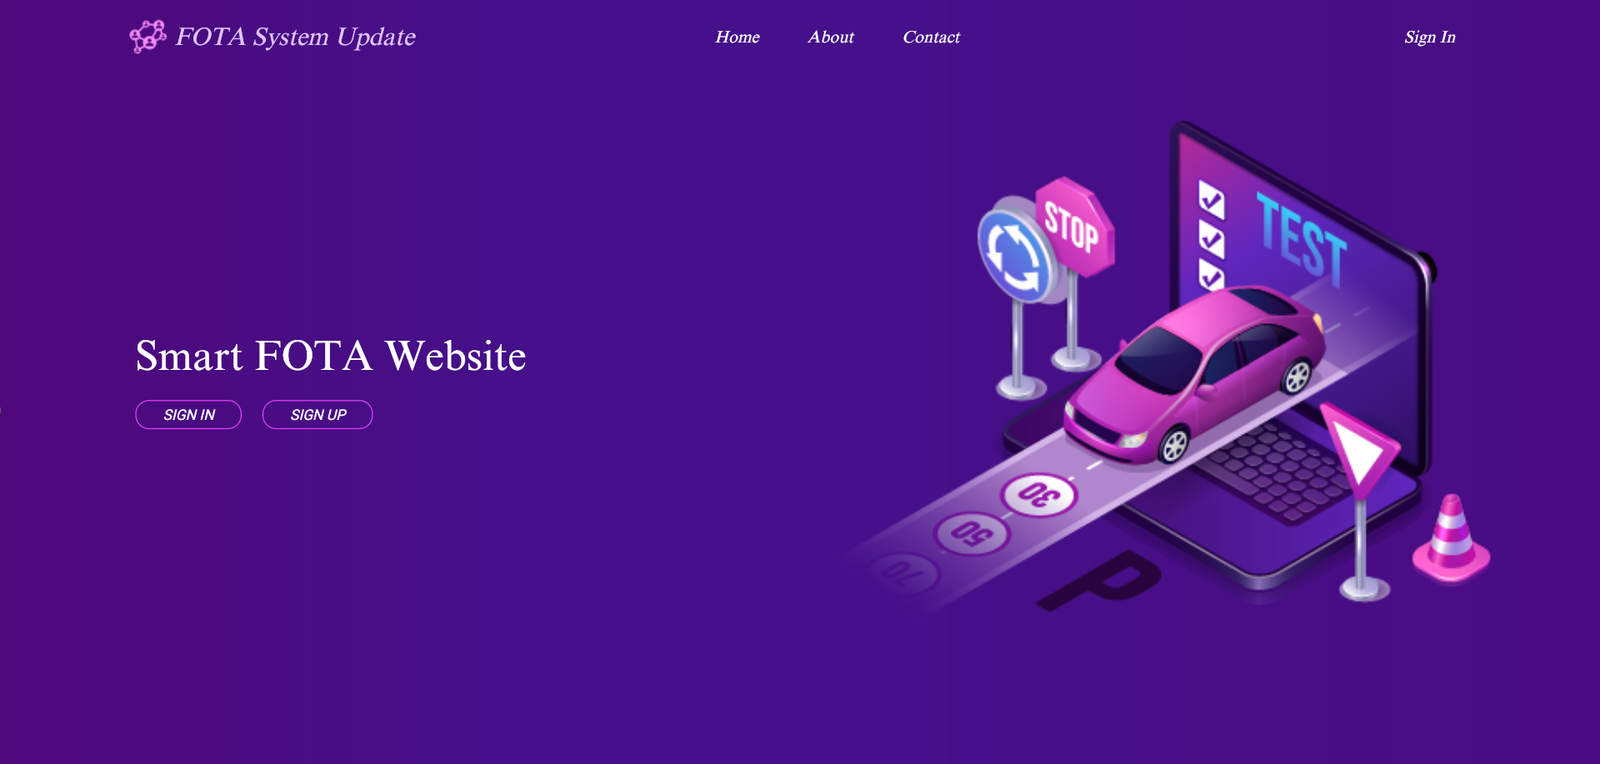
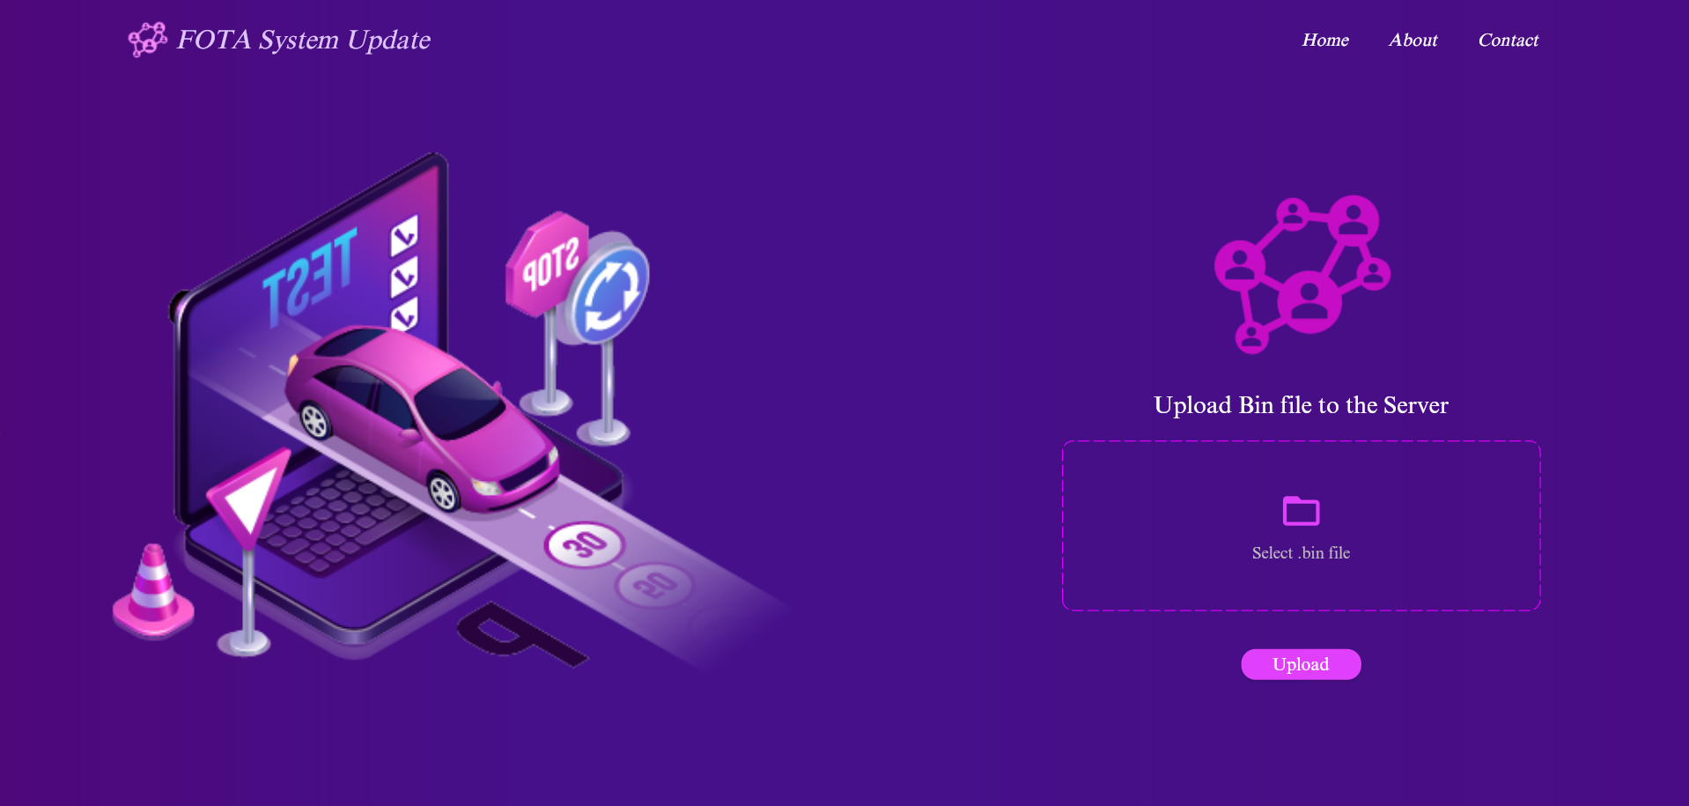
Our Web-APP

Slide 12
Our Web-APP

Slide 13
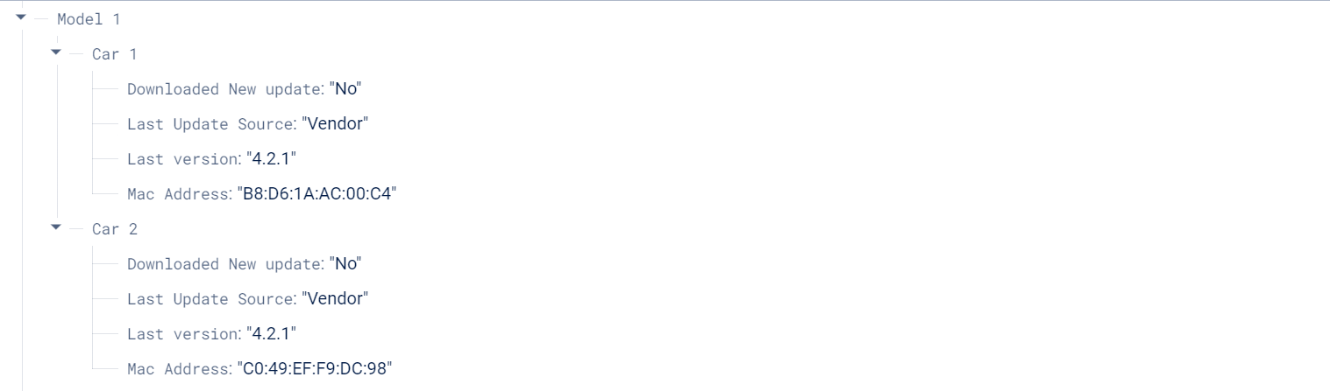
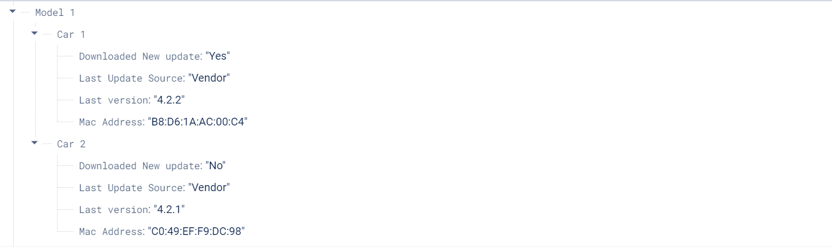
Case 1
An update occurs through server.
Start
OEM Upload an encrypted update
Send OTP SMS Message with the update to the car owner Every 24h
OTP Entered?
No
Yes
Car Download file and decrypt it
Update car state on the server
End

Slide 14
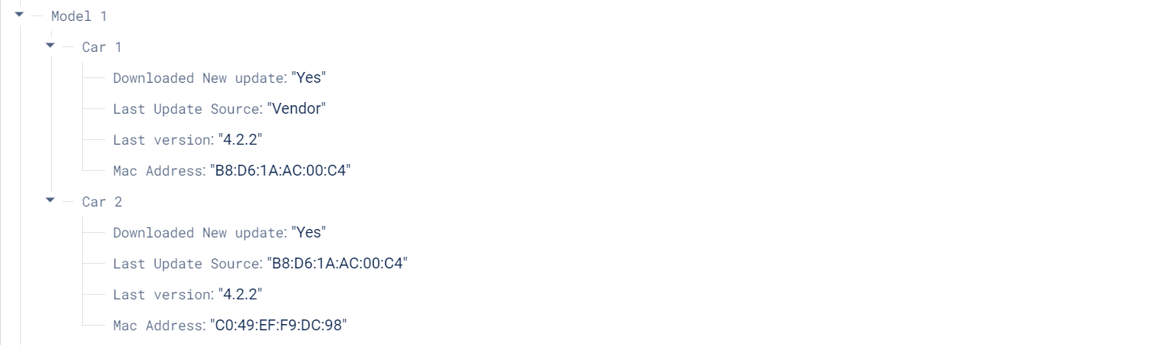
Case 2
An update occurs through V2V as car failed to connect to the server.
Start
Finding nearby authorized Vehicles V2
V1 Request an update
03
No
Bootloader
Send OTP SMS to V1 and V2 to prevent attacks
Car Received?
Yes
Car Received the file and decrypt it
Updated vehicle 1
End

Slide 15
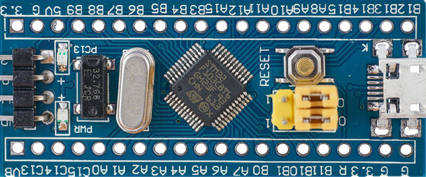
What is a Bootloader?
03
Bootloader
Updating…

Slide 16
Developing a custom bootloader for STM32 MCU
What is a Bootloader?
A bootloader is a small program that runs before the main application and facilitates firmware updates.
The bootloader’s primary role is to load and execute the application firmware.
Updating…

Slide 17
Developing a custom bootloader for STM32 MCU
Normal way is to burn a code to an MCU is to use vendor application.
Vendor application required you with fixed communication protocol and with a specific bootloader architecture.
Updating…

Slide 18

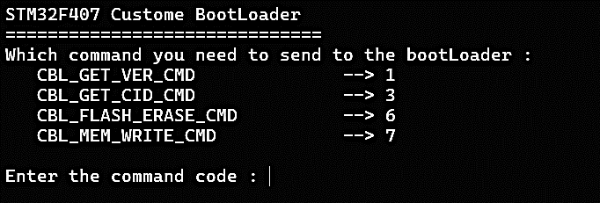
Developing a custom bootloader for STM32 MCU
So, we built our Bootloader based on our application and the features we need.
Communication Protocol to flash is (UART).
Can Erase / Write on Flash memory.
Can Get the version of the current Bootloader.
Can Get Help with the Commands.
Device
Host

Slide 19
Developing a custom bootloader for STM32 MCU

Slide 20
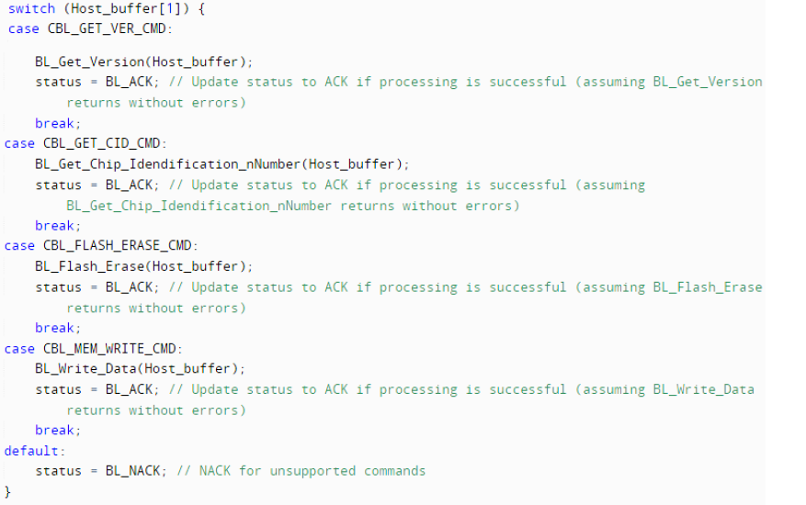
(1 Byte) Length of Data.
(1 Bytes) For Determine Command.
Data with the commands (Pointer to an Address / page size) based on the command.
CRC (Cyclic Redundancy Check) Simple check sum error on (Length, Command, Data).
Length | Command | Data | CRC
Address Write | NO Pages

Slide 21
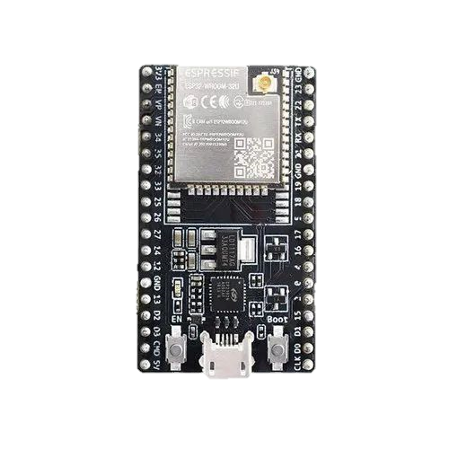
Tx
Rx
Developing a custom bootloader for STM32 MCU
(1 Byte) Length of Data.
(1 Bytes) For Determine Command.
Data with the commands (Pointer to an Address / page size) based on the command.
CRC (Cyclic Redundancy Check) Simple check sum error on (Length, Command, Data).
Length | Command | Data | CRC
Address Write | NO Pages
Buffer which will be received by bootloader and send from Host
Rx
Tx

Slide 22
Developing a custom bootloader for STM32 MCU
04
V2V
Tx
Rx
Rx
Tx

Slide 23
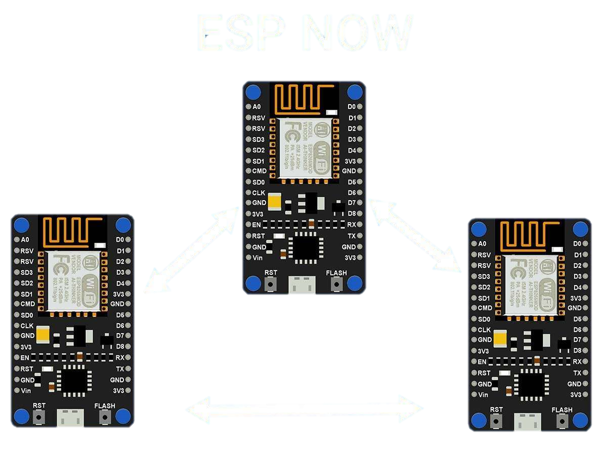
04
V2V
ESP – NOW Protocol

Slide 24
ESP – NOW Protocol

Slide 25
ESP – NOW Protocol
Protocol developed by Espressif
Simple communications between ESP devices
Short packet transmission at 2.4 GHz
No WFI required, encrypted & unencrypted

Slide 26
ESP – NOW Protocol
Unidirectional and Bidiectional modes
President connection after pairing
Works with ESP32 AND ESP8266
Long Range mode up to 480 meters

Slide 27
ESP – NOW Protocol
One-way Communication
Initiator
Initiator
Initiator
Responder
Initiator

Slide 28
ESP – NOW Protocol
One Responder, Multiple Initiator
Initiator
Initiator
Responder
Initiator
Initiator

Slide 29
ESP – NOW Protocol
Two-way communication

Slide 30
ESP – NOW Protocol
Two-way Network

Slide 31
ESP – NOW Protocol
Mix & match ESP32 & ESP8266
Limit of 250 bytes per packet
Need Responders MAC Address

Slide 32
ESP – NOW Protocol
Media Access Control
6-digit hexadecimal number
Unique to every network device
AC
67
B2
F1
4C
C5
MAC Address

Slide 33
ESP – NOW Protocol
FF:FF:FF:FF:FF:FF is Broadcast MAC Address
ESP-NOW supports “pseudo-broadcast” mode
Broadcast to every device in the network
FF
FF
FF
FF
FF
FF
MAC Address

Slide 34
ESP – NOW Protocol
Call back functions called during sending and receiving
Esp_now_register_rcv_cb(&function)
Called when data received
Returns received data
Esp_now_register_send_cb(&function)
Called when data sent
Returns sent state
Returns received status

Slide 35
ESP – NOW Protocol
Send
Initialize ESP-NOW
Register a callback function upon sending
Add a peer device(receiver MAC address)
Send a message to the peer device

Slide 36
ESP – NOW Protocol
Receive
Initialize ESP-NOW
Register a callback function upon receiving
Save message variable

Slide 37
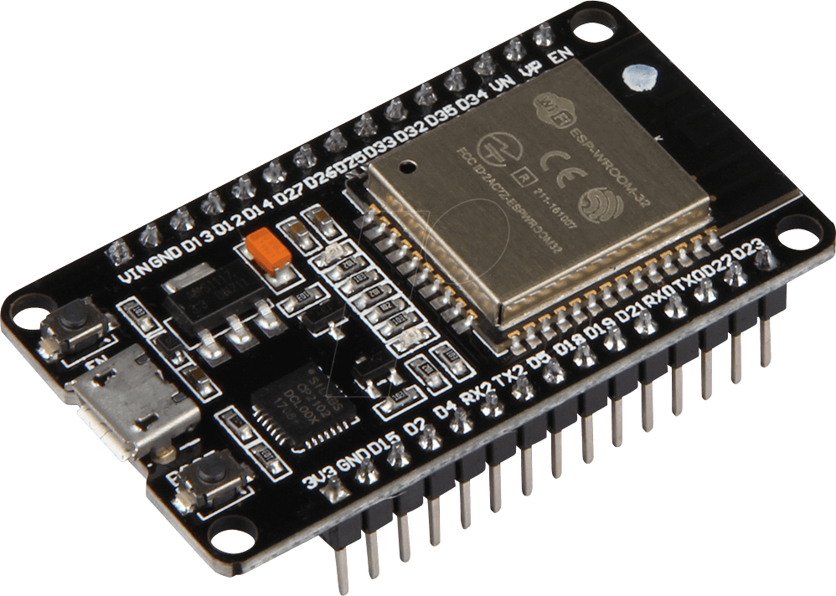
System Architecture
What is the components we used in the V2V system?
V2V Integration with FOTA
How do we flash the code using v2v ?
Challenges faced use
05
Security

Slide 38
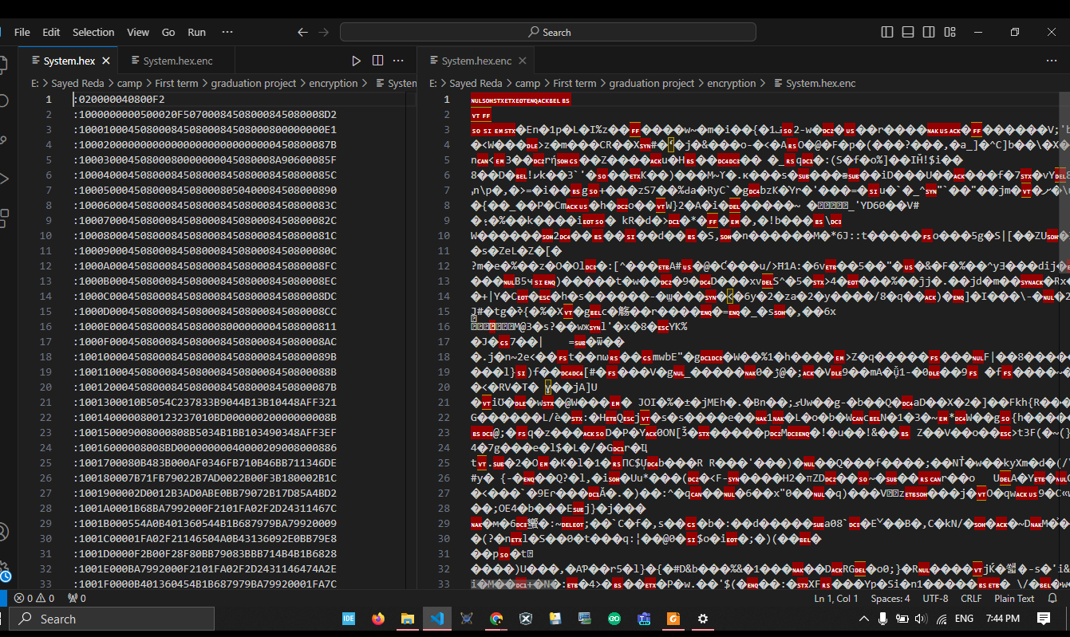
Symmetric Encryption Algorithm
The Advanced Encryption Standard (AES)
Why AES ?
Security.
Performance.
Resource Efficiency.
05
Security

Slide 39
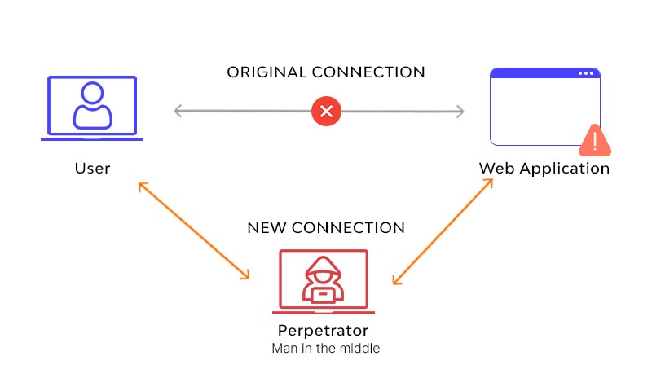

Problems
Symmetric Encryption Algorithm
The Advanced Encryption Standard (AES)
Why AES ?
Security.
Performance.
Resource Efficiency.
Unauthorized Access
Data Integrity Attacks
Man-in-the-Middle (MitM) Attacks

Slide 40
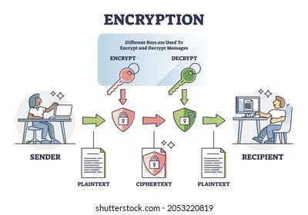
Solutions
Symmetric Encryption Algorithm
The Advanced Encryption Standard (AES)
Why AES ?
Security.
Performance.
Resource Efficiency.
Encryption & Decryption (AES)
OTP

Slide 41

To verify authorized user:
we used one-time password (OTP) For notify user with the new updates.
Why OTP ?
Security.
Authentication.
Convenience.
Symmetric Encryption Algorithm
The Advanced Encryption Standard (AES)
Why AES ?
Security.
Performance.
Resource Efficiency.

Slide 42
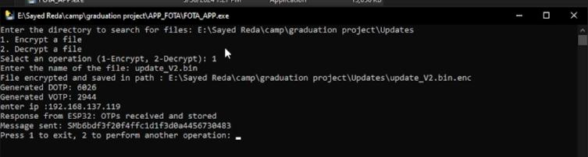
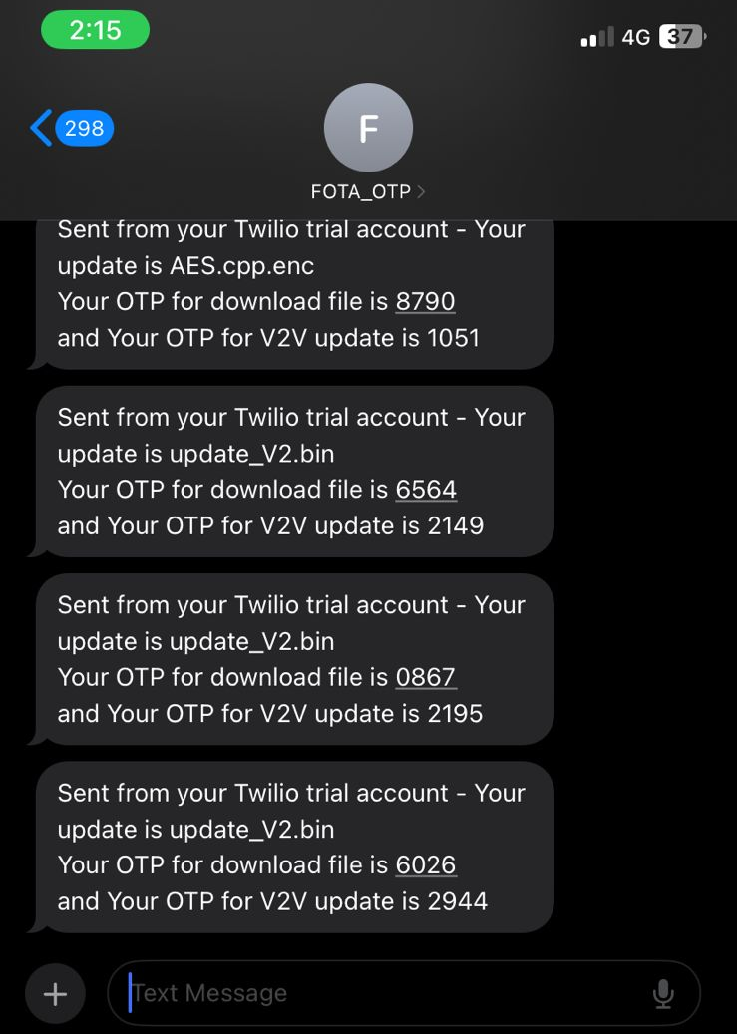

To verify authorized user:
we used one-time password (OTP) For notify user with the new updates.
Why OTP ?
Security.
Authentication.
An Image from our OTP Sender
An Image from our OTP Receiver
An Image from our OTP Receiver

Slide 43
06
PCB Design
An Image from our OTP Sender
An Image from our OTP Receiver
An Image from our OTP Receiver

Slide 44
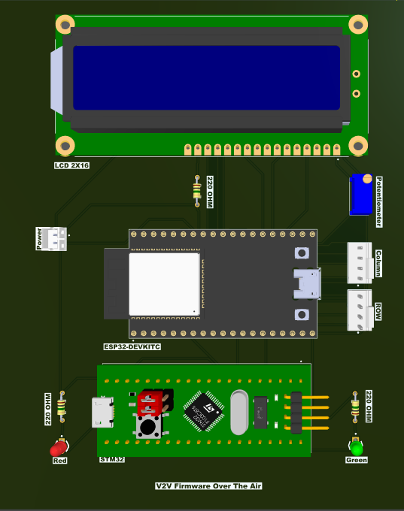
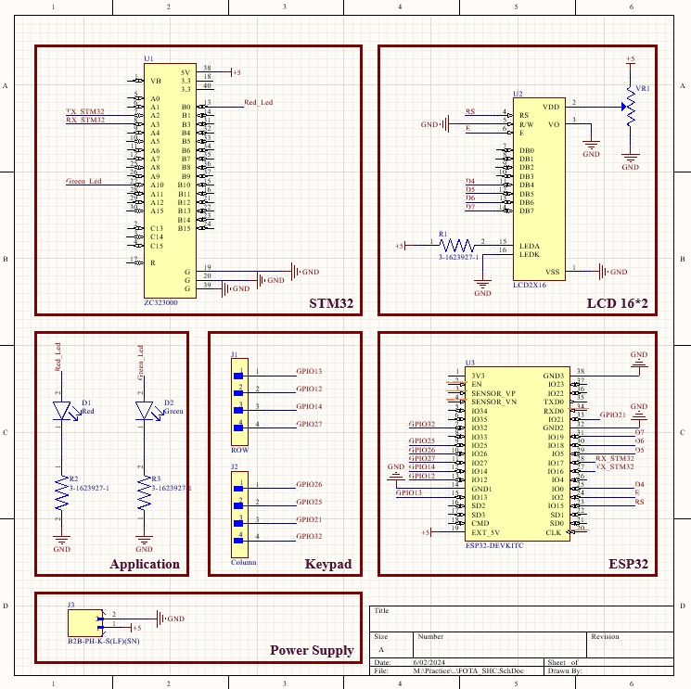
06
PCB Design

Slide 45
07
Future Work

Slide 46
07
Future Work

Slide 47


Future Work
Improved FOTA Update Mechanisms:
Delta Updates: Implement delta update mechanisms to transmit only software changes, reducing data usage and minimizing downtime.
Automatic OTP Serves:
Implement automatic One-Time Password services for enhanced security.

Slide 48

Future Work
Artificial Intelligence and Machine Learning:
Predictive Maintenance: Integrate AI-driven systems to predict and address potential issues before they become critical.

Slide 49

Data Collection and Analysis:
Comprehensive Logging: Create detailed logs of all detected errors, including timestamps, vehicle IDs, locations, and environmental conditions.
Diagnostic Data: Collect diagnostic data from various vehicle systems to provide detailed information on errors' nature and causes.
Thank You
Abdulrhman Mohamed Abdelhamed
Ahmed Khaled Ahmed Zaky
Mazen Khaled Salah
Sayed Reda El Sayed
Yousef Mohamed Anwar

Slide 50
Thank You
Abdulrhman Mohamed Abdelhamed
Ahmed Khaled Ahmed Zaky
Mazen Khaled Salah
Sayed Reda El Sayed
Yousef Mohamed Anwar

